Slide 1
AJAX
Asynchronous JavaScript And XML
UNIT - 5

Slide 2
Syllabi
AJAX: Ajax Client Server Architecture-XML Http Request Object-Call Back Methods;
Web Services: Introduction- Java web services Basics – Creating, Publishing, Testing and Describing a Web services (WSDL)-Consuming a web service, Database Driven web service from an application – SOAP.

Slide 3
AJAX
Asynchronous JavaScript And XML.
AJAX is not a new programming language, but a new way to use existing standards.
AJAX is the art of exchanging data with a server, and updating parts of a web page - without reloading the whole page.
AJAX just uses a combination of:
A browser built-in XMLHttpRequest object (to request data from
a web server)
JavaScript and HTML DOM (to display or use the data)
AJAX allows web pages to be updated asynchronously by exchanging data with a web server behind the scenes.
This means that it is possible to update parts of a web page, without reloading the whole page.

Slide 4
AJAX
Asynchronous JavaScript And XML.
AJAX is a technique for creating fast and dynamic web pages.
Classic web pages, (which do not use AJAX) must reload the entire page if the content should change.
Examples of applications using AJAX: Google Maps, Gmail, Youtube, and Facebook tabs.
The term AJAX is coined on February 18, 2005, by Jesse James Garret in a short essay published a few days after Google released its Maps application.

Slide 5
AJAX is Based on Internet Standards
AJAX is based on internet standards, and uses a combination of:
XMLHttpRequest object (to exchange data asynchronously with a server)
JavaScript/DOM (to display/interact with the information)
CSS (to style the data)
XML (often used as the format for transferring data)
AJAX applications are browser- and platform- independent!

Slide 6
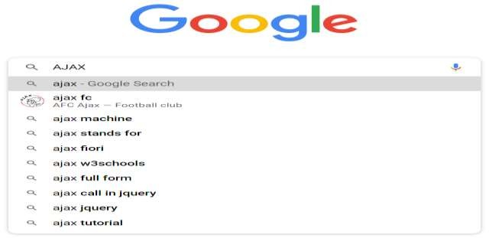
Google Suggest
AJAX was made popular in 2005 by Google, with Google Suggest.
Google Suggest is using AJAX to create a very dynamic web interface: When you start typing in Google's search box, a JavaScript sends the letters off to a server and the server returns a list of suggestions.

Slide 7
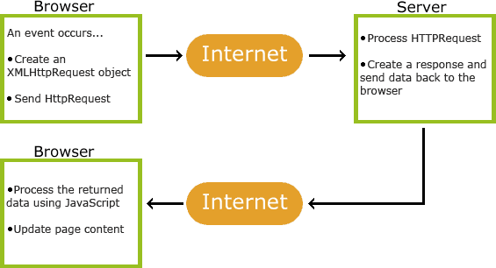
How AJAX Works

Slide 8
How AJAX Works
An event occurs in a web page (the page is loaded, a button is clicked)
An XMLHttpRequest object is created by JavaScript
The XMLHttpRequest object sends a request to a web server
The server processes the request
The server sends a response back to the web page
The response is read by JavaScript
Proper action (like page update) is performed by JavaScript

Slide 9
AJAX - The XMLHttpRequest Object
The keystone of AJAX is the XMLHttpRequest object.
All modern browsers support the XMLHttpRequest object.
The XMLHttpRequest object is used to exchange data with a server.
The XMLHttpRequest object can be used to exchange data with a server behind the scenes. This means that it is possible to update parts of a web page, without reloading the whole page.

Slide 10
AJAX - The XMLHttpRequest Object
All modern browsers (IE7+, Firefox, Chrome, Safari, and Opera) have a built-in XMLHttpRequest object.
Syntax for creating an XMLHttpRequest object:
variable=new XMLHttpRequest();
Old versions of Internet Explorer (IE5 and IE6) uses an ActiveX Object:
variable=new ActiveXObject("Microsoft.XMLHTTP");

Slide 11
var xmlhttp;
if (window.XMLHttpRequest)
AJAX code is cross-browser compatible when you use xmlHttpRequest for different browsers but on using Jquery.Ajax it creates some issue in l
{// code for IE7+, Firefox, Chrome, Opera, Safari
xmlhttp=new XMLHttpRequest();
}
else
{// code for IE6, IE5
xmlhttp=new ActiveXObject("Microsoft.XMLHTTP");
}

Slide 12
XMLHttpRequest.response
The XMLHttpRequest response property returns the response's body content as
an ArrayBuffer, Blob, Document,
JavaScript Object, or DOMString, depending on the value of the request's responseType property.
var body = XMLHttpRequest.response;

Slide 13
var url = 'somePage.html'; //A local page
function load(url, callback) {
var xhr = new XMLHttpRequest();
xhr.onreadystatechange = function() { if (xhr.readyState === 4) { callback(xhr.response);
}
}
xhr.open('GET', url, true);
xhr.send('');
}

Slide 14
Send a Request To a Server
To send a request to a server, we use the open() and send() methods of the XMLHttpRequest object:
xmlhttp.open("GET","ajax_info.txt",true); xmlhttp.send();
Method | Description
open(method,url,async) | Specifies the type of request, the URL, and if the request should be handled asynchronously or not. method: the type of request: GET or POST url: the location of the file on the server async: true (asynchronous) or false (synchronous)
send(string) | Sends the request off to the server. string: Only used for POST requests

Slide 15
<html> <script>
function showHint(str)
{
var xmlhttp;
if (str.length==0)
{
document.getElementById("txtHint").innerHTML="";
return;
}
if (window.XMLHttpRequest)
{// code for IE7+, Firefox, Chrome, Opera, Safari xmlhttp=new XMLHttpRequest();
}
else
{// code for IE6, IE5
xmlhttp=new ActiveXObject("Microsoft.XMLHTTP");
}
xmlhttp.onreadystatechange=function()
{
if (xmlhttp.readyState==4 && xmlhttp.status==200)
{
document.getElementById("txtHint").innerHTML=xmlhttp.responseText;
}
}
xmlhttp.open("GET","gethint.php?q="+str,true); xmlhttp.send();
}

Slide 16
</script>
</head>
<form>
Enter Name: <input type="text" value="" onkeyup="showHint(this.value);">
</form>
<p>
<div id="txtHint"><b>User info will be listed here.</b></div>
</p>
</html>

Slide 17
<?php
// Fill up array with names
$a[]="Wenche";
$a[]="Vicky";
$a[]="Mahesh";
//get the q parameter from URL
$q=$_GET["q"];
//lookup all hints from array if length of q>0
if (strlen($q) > 0)
{
$hint="";
for($i=0; $i<count($a); $i++)
{
if (strtolower($q)==strtolower(substr($a[$i],0,strlen($q))))
{
if ($hint=="")
{
$hint=$a[$i];
}
else
{
$hint=$hint." , ".$a[$i];
}
}
}
}
// Set output to "no suggestion" if no hint were
//found or to the correct values if ($hint == "")
{
$response="no suggestion";
}
else
{
$response=$hint;
}
//output the response echo $response;
?>

Slide 18
XML Http Request Object
XMLHttpRequest Methods
abort()
Cancels the current request.
getAllResponseHeaders()
Returns the complete set of HTTP headers as a string.
getResponseHeader( headerName )
Returns the value of the specified HTTP header.
open( method, URL )
open( method, URL, async )
open( method, URL, async, userName )
open( method, URL, async, userName, password )
Specifies the method, URL, and other optional attributes of a request.
send( content )
Sends the request.
setRequestHeader( label, value )
Adds a label/value pair to the HTTP header to be sent. XMLHttpRequest Properties
onreadystatechange
An event handler for an event that fires at every state change.
readyState
The readyState property defines the current state of the XMLHttpRequest object.

Slide 19
XML Http Request Object
received from the server.
responseText
Returns the response as a string.
responseXML
Returns the response as XML. This property returns an XML document object, which can be examined and parsed using the W3C DOM node tree methods and properties.
status
Returns the status as a number (e.g., 404 for "Not Found" and 200 for "OK").
statusText
Returns the status as a string (e.g., "Not Found" or "OK").

Slide 20
onreadystatechange Property
Property | Description
onreadystatechange | Defines a function to be called when the readyState property changes
readyState | Holds the status of the XMLHttpRequest. 0: request not initialized 1: server connection established 2: request received 3: processing request 4: request finished and response is ready
status | 200: "OK" 403: "Forbidden" 404: "Page not found" For a complete list go to the Http Messages Reference
statusText | Returns the status-text (e.g. "OK" or "Not Found")

Slide 21
Callback function
Callback functions are used to handle responses from the server in Ajax.
A callback function can be either a
named function or
an anonymous function.

Slide 22
Callback function as an anonymous function
function start() {
var xmlhttp = new XMLHttpRequest();
var contentDiv = document.getElementById("Content"); xmlhttp.open("POST", "Demo", true); xmlhttp.onreadystatechange=function() {
if (xmlhttp.readyState==4 && xmlhttp.status==200) {
console.log(xmlhttp.responseText);
}
}
xmlhttp.setRequestHeader("Content-Type","application/x-www-
form-urlencoded;charset=UTF-8"); xmlhttp.send("FirstName=Nat&LastName=Dunn");
}

Slide 23
Callback function as an named function
Create an XMLHttpRequest object in the global scope (outside of the following two functions).
var xmlhttp = new XMLHttpRequest();
Write a function to use as the callback function. function myCallBack() {
if (xmlhttp.readyState==4 && xmlhttp.status==200) {
console.log(xmlhttp.responseText);
}
}

Slide 24
Callback function as an named function
3. Set the value of the onreadystatechange property to the name of the function.
function start() {
var xmlhttp = new XMLHttpRequest();
var contentDiv = document.getElementById("Content"); xmlhttp.open("POST", "Demo", true); xmlhttp.onreadystatechange=myCallBack; xmlhttp.setRequestHeader("Content-Type","application/x-www- form-urlencoded;charset=UTF-8"); xmlhttp.send("FirstName=Nat&LastName=Dunn");
}

Slide 25
AJAX XML Example
<script>
function loadDoc() {
var xhttp = new XMLHttpRequest(); xhttp.onreadystatechange = function() {
if (this.readyState == 4 && this.status == 200) {
myFunction(this);
}
};
xhttp.open("GET", “CDCatalog.xml", true); xhttp.send();
}
function myFunction(xml) {
var i;
var xmlDoc = xml.responseXML;
var table="<tr><th>Artist</th><th>Title</th></tr>";
var x = xmlDoc.getElementsByTagName(“cd");
for (i = 0; i <x.length; i++) { table += "<tr><td>" +
x[i].getElementsByTagName("artist")[0].childNodes[0].nodeValue +
"</td><td>" +
x[i].getElementsByTagName("title")[0].childNodes[0].nodeValue + "</td></tr>";
}
document.getElementById("demo").innerHTML = table;
}
</script>
</body>
</html>

Slide 26
What is synchronous request in AJAX
AJAX can access the server both synchronously and asynchronously:
Synchronously, in which the script stops and waits for the server to send back a reply before continuing.
Synchronous request in ajax means javascript will stop processing your program until a result has been obtained from the server. Until it is processing the browser is frozen.
Example if a user needs to signout after check out something online. In this case it is better to synchronize ajax call

Slide 27
xmlhttp.onreadystatechange=function()
{
if (xmlhttp.readyState==4 && xmlhttp.status==200)
{
document.getElementById("txtHint").innerHTML=xmlhttp.responseText;
}
}
xmlhttp.open("GET","gethint.php?q="+str, false);
xmlhttp.send();
}

Slide 28
What is Asynchronous request in AJAX
AJAX can access the server both synchronously and asynchronously:
Asynchronously, in which the script allows the page to continue to be processed and handles the reply if and when it arrives.
– Asynchronous ajax will initiate a request to the server and then return control to the browser. After sometime you can still manage the result return from server(means server responds, timedout, error, etc.).

Slide 29
Is AJAX code cross browser compatible?
Cross-browser compatibility is the ability of a website or web application to function across different browsers and degrade gracefully when browser features are absent or lacking.
Cross-browser compatibility can be defined as the ability of a website, application or script to support various
web browsers identically.
Not totally. Most browsers offer a native XMLHttpRequest JavaScript object, while another one (Internet Explorer) require to get it as an ActiveX object. Once you have the object, you're out of the realm of browser differences.
AJAX code is cross-browser compatible when you use xmlHttpRequest for different browsers but on
using Jquery.Ajax it creates some issue in legacy IE browsers.

Slide 30
if (window.XMLHttpRequest)
{// code for IE7+, Firefox, Chrome, Opera, Safari xmlhttp=new XMLHttpRequest();
}
else
{// code for IE6, IE5
xmlhttp=new ActiveXObject("Microsoft.XMLHTTP");
}

Slide 31
Web Services
UNIT - 5

Slide 32
Syllabi
AJAX: Ajax Client Server Architecture-XML Http Request Object-Call Back Methods;
Web Services: Introduction- Java web services Basics – Creating, Publishing, Testing and Describing a Web services (WSDL)-Consuming a web service, Database Driven web service from an application – SOAP.

Slide 33
Web Services
Web services are open standard (XML, SOAP, HTTP, etc.) based web applications that interact with other web applications for the purpose of exchanging data.
Web services can convert your existing applications into web applications.
Web services are self-contained, modular, distributed, dynamic applications that can be described, published, located, or invoked over the network to create products, processes, and supply chains.
Web services are XML-based information exchange systems that use the Internet for direct application-to- application interaction. These systems can include programs, objects, messages, or documents.

Slide 34
Web Services
A web service is a collection of open protocols and standards used for exchanging data between applications or systems.
Software applications written in various programming languages and running on various platforms can use web services to exchange data over computer networks like the Internet in a manner similar to inter-process communication on a single computer.
This interoperability (e.g., between Java and Python, or Windows and Linux applications) is due to the use of open standards.

Slide 35
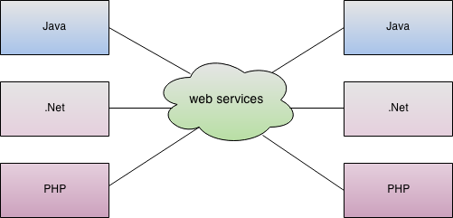

Slide 36
Web Service is
A web service is any piece of software that makes itself available over the internet and uses a standardized XML messaging system. XML is used to encode all communications to a web service.
For example, a client invokes a web service by sending an XML message, then waits for a corresponding XML response.
The term Web service is either: a service offered by an electronic device to another electronic device, communicating with each other via the World Wide Web, or a server running on a computer device, listening for requests at a particular port over a network, serving web documents.

Slide 37
Web Service : Example
Web services is a technology that enables interaction between any two
applications.
Consider a bus booking site.
When user selects a bus and input all the information, he has to make the payment and for that the site requires user to select a mode of payment . If user selects CREDIT card as the mode of payment then user has to input all the credit card details. Now these details cannot be authenticated by the bus booking site, it has to request the bank to authenticate the details provided by the user. But how will it interact with the bank because the bank application can be developed in any technology. The bus booking site has no control over which technology the bank application has been developed.
That's where webservices comes into picture.
It makes the interaction between two applications possible. It accomplishes by serving the data in the standard format such as XML or JSON.
In this example the bus booking site will send all the CREDIT card related information. The bank application will then authenticate the credentials and then return appropriate response to the bus booking site.

Slide 38
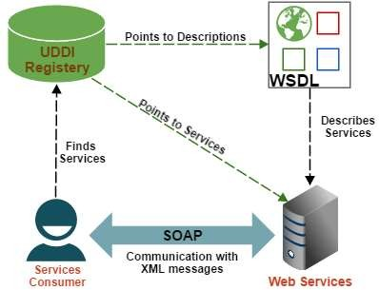
How Does a Web Service Work
A web service enables communication among various applications by using open standards such as HTML, XML, WSDL, and SOAP.
A web service takes the help of −
XML to tag the data
SOAP to transfer a message
WSDL to describe the availability of service
UDDI list the available services

Slide 39
Components of Web Services
The basic web services platform is XML + HTTP.
All the standard web services work using the following components −
SOAP (Simple Object Access Protocol)
SOAP is a messaging protocol specification for exchanging structured information in the implementation of web services in computer networks.
UDDI (Universal Description, Discovery and Integration)
The UDDI specification defines a way to publish and discover information about web services. UDDI registries use the UDDI specification to publish directory listings of web services.
WSDL (Web Services Description Language)
WSDL is an XML-based protocol for information exchange in decentralized and distributed environments. WSDL definitions describe how to access a web service and what operations it will perform. WSDL is a language for describing how to interface with XML-based services.

Slide 40
Example
Consider a simple account-management and order processing system. The accounting personnel use a client application built with Visual Basic or JSP to create new accounts and enter new customer orders.
The processing logic for this system is written in Java and resides on a Solaris machine, which also interacts with a database to store information.

Slide 41
Example
The steps to perform this operation are as follows −
The client program bundles the account registration information into a SOAP message.
This SOAP message is sent to the web service as the body of an HTTP POST request.
The web service unpacks the SOAP request and converts it into a command that the application can understand.
The application processes the information as required and responds with a new unique account number for that customer.
Next, the web service packages the response into another SOAP message, which it sends back to the client program in response to its HTTP request.
The client program unpacks the SOAP message to obtain the results of the account registration process.

Slide 42
Types of web services
There are two types of web services:
RESTful Web Servies
SOAP Web Services

Slide 43
RESTful Web Services
REST stands for REpresentational State Transfer. It is developed by Roy Thomas Fielding who also developed HTTP.
The main goal of RESTful web services is to make web services more effective.
RESTful web services try to define services using the different concepts that are already present in HTTP.
REST is an architectural approach, not a protocol.
It does not define the standard message exchange format.
We can build REST services with both XML and JSON. JSON is more popular format with REST.
JSON stands for JavaScript Object Notation. JSON is a lightweight format for storing and transporting data. JSON is often used when data is sent from a server to a web page. JSON is "self- describing" and easy to understand.
The key abstraction is a resource in REST. A resource can be anything. It can be accessed through a Uniform Resource Identifier (URI).

Slide 44
RESTful Web Services
The resource has representations like XML, HTML, and JSON. The current state is captured by representational resource. When we request a resource, we provide the representation of the resource. The important methods of HTTP are:
GET: It reads a resource.
PUT: It updates an existing resource.
POST: It creates a new resource.
DELETE: It deletes the resource.
For example, if we want to perform the following actions in the social media application, we get the corresponding results.
POST /users: It creates a user.
GET /users/{id}: It retrieve the detail of one user.
GET /users: It retrieve the detail of all users.
DELETE /users: It delete all users.
DELETE /users/{id}: It delete a user.
GET /users/{id}/posts/post_id: It retrieve the detail of a specific post.
POST / users/{id}/ posts: It creates a post for a user.
GET /users/{id}/post: Retrieve all posts for a user

Slide 45
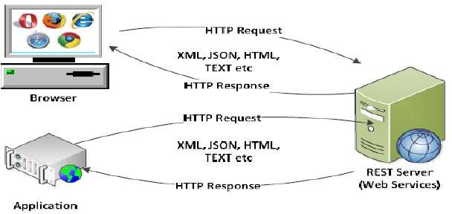
RESTFul Web Service Architecture

Slide 46
RESTful Service Constraints
There must be a service producer and service consumer.
The service is stateless.
The service result must be cacheable.
The interface is uniform and exposing resources.
The service should assume a layered architecture.

Slide 47
Advantages of RESTful web services
RESTful web services are platform-independent.
It can be written in any programming language and can be executed on any platform.
It provides different data format like JSON, text, HTML, and XML.
It is fast in comparison to SOAP because there is no strict specification like SOAP.
These are reusable.
These are language neutral.

Slide 48
SOAP Web Services
REST defines an architectural approach whereas SOAP poses a restriction on the format of the XML. XML transfer data between the service provider and service consumer. Remember that SOAP and REST are not comparable.
SOAP: SOAP acronym for Simple Object Access Protocol. It defines the standard XML format. It also defines the way of building web services. We use Web Service Definition Language (WSDL) to define the format of request XML and the response XML.
For example, we have requested to access
the Todo application from the Facebook application. The Facebook application sends an XML request to the Todo application. Todo application processes the request and generates the XML response and sends back to the Facebook application.

Slide 50
Java Web Services
In Java, a web service is implemented as a class. The class that represents the web service resides on a server—it’s not part of the client application.
Making a web service available to receive client requests is known as publishing a web service; using a web service from a client application is known as consuming a web service.

Slide 51
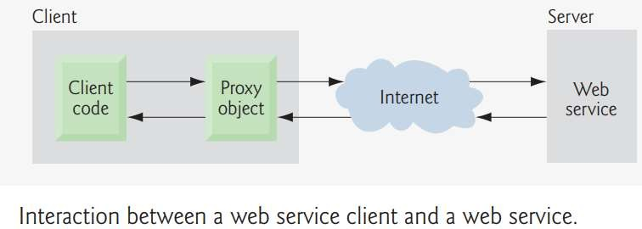
Java Web Services
An application that consumes a web service consists of two parts—an object of a proxy class for interacting with the web service and a client application that consumes the web service by invoking methods on the object of the proxy class.
The client code invokes methods on the proxy object, which handles the details of communicating with the web service (such as passing method arguments to the web service and receiving return values from the web service) on the client’s behalf.
This communication can occur over a local network, over the Internet or
even with a web service on the same computer.
The web service performs the corresponding task and returns the results
to the proxy object, which then returns the results to the client code.

Slide 52
Java Web Services
The java web service application can be accessed by other programming languages such as .Net and PHP.
Java web service application perform communication through WSDL (Web Services Description Language).
There are two ways to write java web service application code: SOAP and RESTful.

Slide 53
Java Web Services API
There are two main API's defined by Java for developing web service applications since JavaEE6.
JAX-WS (Java API for XML Web Services): for SOAP web services. The are two ways to write JAX-WS application code: by
RPC style and
Document style.
JAX-RS(Java API for RESTful Web Services): for RESTful web services. There are mainly 2 implementation currently in use for creating JAX-RS application:
Jersey and
RESTeasy.

Slide 54
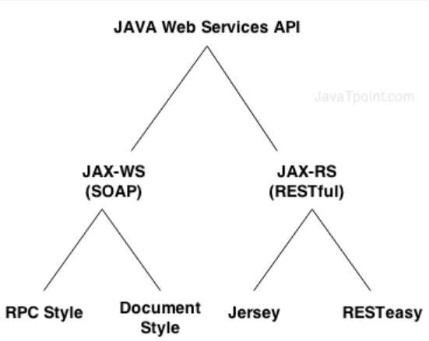

Slide 55
JAX-WS
There are two ways to develop JAX-WS example.
RPC style
Document style

Slide 56
RPC Style
RPC style web services use method name and parameters to generate XML structure.
The generated WSDL is difficult to be validated
against schema.
In RPC style, SOAP message is sent as many elements.
RPC style message is tightly coupled.
In RPC style, SOAP message keeps the operation name.
In RPC style, parameters are sent as discrete values.

Slide 57
Document Style
Document style web services can be validated against predefined schema.
In document style, SOAP message is sent as a single document.
Document style message is loosely coupled.
In Document style, SOAP message loses the operation name.
In Document style, parameters are sent in XML format.

Slide 58
JAX-RS
There are two main implementation of JAX-RS API.
Jersey
RESTEasy

Slide 59
JAX-RS Annotations
The javax.ws.rs package contains JAX-RS annotations
Annotation | Description
Path | It identifies the URI path. It can be specified on class or method.
PathParam | represents the parameter of the URI path.
GET | specifies method responds to GET request.
POST | specifies method responds to POST request.
PUT | specifies method responds to PUT request.
HEAD | specifies method responds to HEAD request.
DELETE | specifies method responds to DELETE request.
OPTIONS | specifies method responds to OPTIONS request.
FormParam | represents the parameter of the form.
QueryParam | represents the parameter of the query string of an URL.
HeaderParam | represents the parameter of the header.
CookieParam | represents the parameter of the cookie.
Produces | defines media type for the response such as XML, PLAIN, JSON etc. It defines the media type that the methods of a resource class or MessageBodyWriter can produce.
Consumes | It defines the media type that the methods of a resource class or MessageBodyReader can produce.

Slide 60
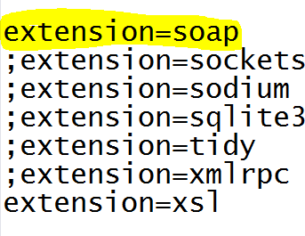
php.ini (Enable soap)

Slide 61
Features of WSDL
WSDL is an XML-based protocol for information exchange in decentralized and distributed environments.
WSDL definitions describe how to access a web service and what operations it will perform.
WSDL is a language for describing how to interface with XML-based services.
WSDL is an integral part of Universal Description, Discovery, and Integration (UDDI), an XML-based worldwide business registry.
WSDL is the language that UDDI uses.
WSDL is pronounced as 'wiz-dull' and spelled out as 'W-S-D-L'.

Slide 62
WSDL Usage
WSDL is often used in combination with SOAP and XML Schema to provide web services over the Internet.
A client program connecting to a web service can read the WSDL to determine what functions are available on the server.
Any special datatypes used are embedded in the WSDL file in the form of XML Schema.
The client can then use SOAP to actually call one of the functions listed in the WSDL.

Slide 63
WSDL Elements
A WSDL document contains the following elements:
Definition : It is the root element of all WSDL documents. It defines the name of the web service, declares multiple namespaces used throughout the remainder of the document, and contains all the service elements described here.
Data types : The data types to be used in the messages are in the form of XML schemas.
Message : It is an abstract definition of the data, in the form of a message presented either as an entire document or as arguments to be mapped to a method invocation.
Operation : It is the abstract definition of the operation for a message, such as naming a method, message queue, or business process, that will accept and process the message.
Port type : It is an abstract set of operations mapped to one or more end-points, defining the collection of operations for a binding; the collection of operations, as it is abstract, can be mapped to multiple transports through various bindings.

Slide 64
WSDL Elements
Binding : It is the concrete protocol and data formats for the operations and messages defined for a particular port type.
Port : It is a combination of a binding and a network address, providing the target address of the service communication.
Service : It is a collection of related end-points encompassing the service definitions in the file; the services map the binding to the port and include any extensibility definitions.
In addition to these major elements, the WSDL specification also defines the following utility elements:
Documentation: This element is used to provide human- readable documentation and can be included inside any other WSDL element.
Import : This element is used to import other WSDL documents or XML Schemas.

Slide 65
The WSDL Document Structure
<definitions>
<types>
definition of types........
</types>
<message>
definition of a message....
</message>
<portType>
<operation>
definition of a operation.......
</operation>
</portType>
<binding>
definition of a binding....
</binding>
<service>
definition of a service....
</service>
</definitions>

Slide 66
WSDL - <definition> Element
The <definitions> element must be the root element of all WSDL documents. It
defines the name of the web service.
Here is the piece of code from the last chapter that uses the definitions element.
<definitions name="HelloService" targetNamespace="http://www.examples.com/wsdl/HelloService.wsdl" xmlns="http://schemas.xmlsoap.org/wsdl/" xmlns:soap="http://schemas.xmlsoap.org/wsdl/soap/" xmlns:tns="http://www.examples.com/wsdl/HelloService.wsdl" xmlns:xsd="http://www.w3.org/2001/XMLSchema">
................................................
</definitions>

Slide 67
Java Web Services
In Java, a web service is implemented as a class. The class that represents the web service resides on a server—it’s not part of the client application.
Making a web service available to receive client requests is known as publishing a web service; using a web service from a client application is known as consuming a web service.

Slide 68
Java Web Services
An application that consumes a web service consists of two parts—an object of a proxy class for interacting with the web service and a client application that consumes the web service by invoking methods on the object of the proxy class.
The client code invokes methods on the proxy object, which handles the details of communicating with the web service (such as passing method arguments to the web service and receiving return values from the web service) on the client’s behalf.
This communication can occur over a local network, over the Internet or
even with a web service on the same computer.
The web service performs the corresponding task and returns the results
to the proxy object, which then returns the results to the client code.

Slide 69
CREATING, PUBLISHING, TESTING AND DESCRIBING A WEB SERVICES (WSDL)
Example - The following subsections demonstrate how to create, publish and test a HugeInteger web service that performs calculations with positive integers up to 100 digits long (maintained as arrays of digits).
Such integers are much larger than Java’s integral primitive types can represent.
The HugeInteger web service provides methods that take
two “huge integers” (represented as Strings) and determine their sum, their difference, which is larger, which is smaller or whether the two numbers are equal.
These methods will be services available to other applications via the web—hence the term web services.

Slide 70
1. Creating a Web Application Project and Adding a Web Service Class in Netbeans
Creating a Web Application Project in Netbeans 5.5 To create a web application,
perform the following steps:
Select File > New Project to open the New Project dialog.
Select Web from the dialog’s Categories list, then select Web Application from the Projects list. Click Next >.
Specify the name of your project (HugeInteger) in the Project Name field and specify where you’d like to store the project in the Project Location field. You can click the Browse button to select the location.
Select Sun Java System Application Server from the Server drop-
down list.
Select Java EE 5 from the J2EE Version drop-down list.
Click Finish to dismiss the New Project dialog.
This creates a web application that will run in a web browser. When you create a Web Application in Netbeans, the IDE generates additional files that support the web application.

Slide 71
Adding a Web Service Class to a Web Application Project To create a web service, perform the following steps to add a web service class to the project:
Under the Projects tab in Netbeans (just below the File menu), right click the HugeInteger project’s node and select New > Web Service… to open the New Web Service dialog.
Specify HugeInteger in the Web Service Name field.
Specify com.deitel.jhtp7.ch28.hugeinteger in the Package field.
Click Finish to dismiss the New Web Service dialog.
The IDE generates a sample web service class with the name you
specified in Step 2.
In this class, you’ll define the methods that your web service makes available to client applications. When you eventually build your application, the IDE will generate other supporting files (which we’ll discuss shortly) for your web service.

Slide 72
2. Defining the HugeInteger Web Service in Netbeans
Figure 28.2 contains the HugeInteger web service’s code.
You can implement this code yourself in the HugeInteger.java file created in Section 28.3.1, or you can simply replace the code in HugeInteger.java with a copy of our code from this example’s folder. You can find this file in the project’s src\java\com\deitel\jhtp7\ch28\hugeinteger folder.
The book’s examples can be downloaded from
www.deitel.com/books/jhtp7.

Slide 73
3. Publishing the HugeInteger Web Service from Netbeans
Now that we’ve created the HugeInteger web service class, we’ll use Netbeans to build and publish (i.e., deploy) the web service so that clients can consume its services. Netbeans handles all the details of building and deploying a web service for you. This includes creating the framework required to support the web service. Right click the project name (HugeInteger) in the Netbeans Projects tab to display the
pop-up menu shown in Fig. 28.3. To determine if there are any compilation errors in your project, select the Build Project option. When the project compiles successfully, you can select Deploy Project to deploy the project to the server you selected when you set up the web application in Section 28.3.1. If the code in the project has changed since the last build, selecting Deploy Project also builds the project.
Selecting Run Project executes the web application. If the web application was not previously built or deployed, this option performs these tasks first. Note that both the Deploy Project and Run Project options also start the application server (in our case Sun Java System Application Server) if it is not already running. To ensure that all source-code files in a project are recompiled during the next build operation, you can use the Clean Project or Clean and Build Project options. If you have not already done so, select Deploy Project now.

Slide 74
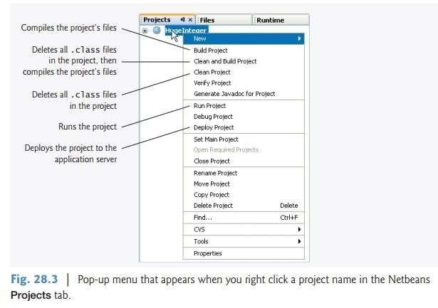

Slide 75
4. Testing the HugeInteger Web Service with Sun Java System Application Server’s Tester Web page
The next step is to test the HugeInteger web service. We previously selected the Sun Java System Application Server to execute this web application. This server can dynamically create a web page for testing a web service’s methods from a web browser. To enable this capability:
Right click the project name (HugeInteger) in the Netbeans Projects tab and select Properties from the pop-up menu to display the Project Properties dialog.
Click Run under Categories to display the options for running the project.
In the Relative URL field, type /HugeIntegerService?Tester.
Click OK to dismiss the Project Properties dialog.

Slide 76
The Relative URL field specifies what should happen when the web application executes. If this field is empty, then the web application’s default JSP displays when you run the project. When you specify
/HugeIntegerService?Tester in this field, then run the project, Sun Java System Application Server builds the Tester web page and loads it into your web browser. Figure 28.4 shows the Tester web page for the HugeInteger web service. Once you’ve deployed the web service, you can also type the URL
http://localhost:8080/HugeInteger/HugeIntegerService?Tester in your web browser to view the Tester web page. Note that
HugeIntegerService is the name (specified in line 11 of Fig. 28.2) that
clients, including the Tester web page, use to access the web service.

Slide 77
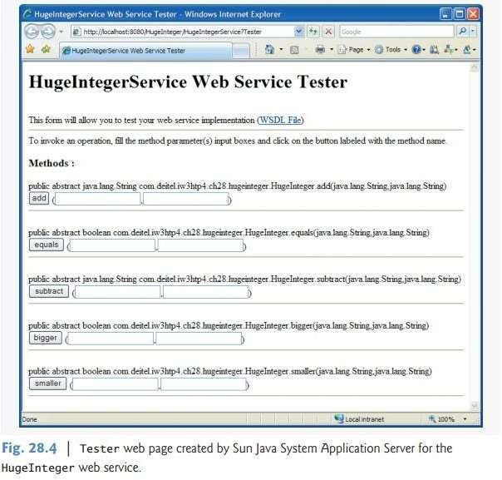

Slide 78
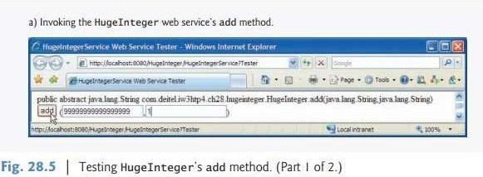
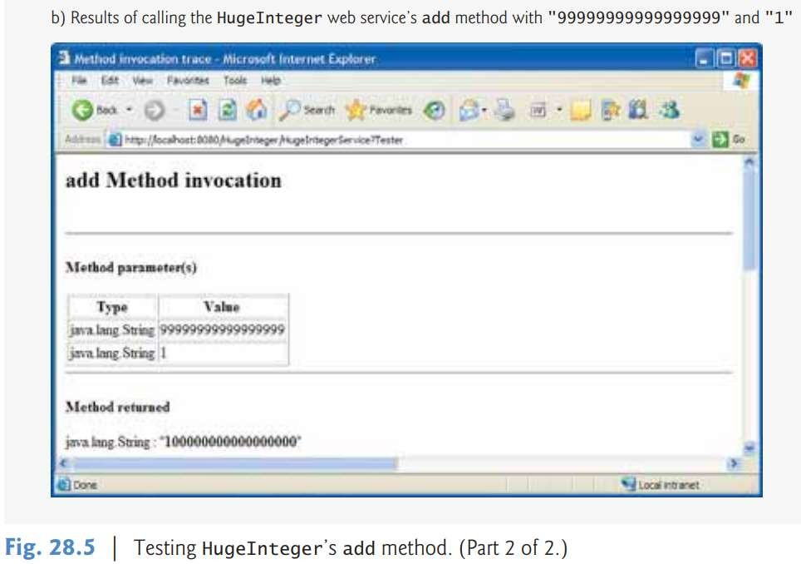

Slide 79
5 Describing a Web Service with the Web Service Description Language (WSDL)
To view the WSDL for the HugeInteger web service (Fig. 28.6), enter the following
URL in your browser:
http://localhost:8080/HugeInteger/HugeIntegerService?WSDL
or click the WSDL File link in the Tester web page (shown in Fig. 28.4). Accessing the HugeInteger Web Service’s WSDL from Another Computer Eventually, you’ll want clients on other computers to use your web service. Such clients need access to your web service’s WSDL, which they would access with the following URL: http://host:8080/HugeInteger/HugeIntegerService?WSDL where host is the hostname or IP address of the computer on which the web service is deployed. As we discussed in Section 28.3.4, this will work only if your computer allows HTTP connections from other computers—as is the case for publicly accessible web and application servers.

Slide 80
Consuming a web service
Now that we’ve defined and deployed web service, we can consume it from a client application.
A web service client can be any type of application or even another web service.
You enable a client application to consume a web service by adding a web service reference to the application.
This process defines the proxy class that allows the client to access the web service

Slide 81
Creating a Client in Netbeans to Consume the HugeInteger Web Service
To create a client Java desktop application in Netbeans:
Select File > New Project… to open the New Project dialog.
Select General from the Categories list and Java Application from the Projects list, then click Next >.
Specify the name UsingHugeInteger in the Project Name field and uncheck the Create Main Class
checkbox. In a moment, you’ll add a subclass of JFrame that contains a main method.
Click Finish to create the project.

Slide 82
Adding a Web Service Reference to an Application
Next, you’ll add a web service reference to your application so that it can interact with the HugeInteger web service.
To add a web service reference, perform the following steps.
Right click the project name (UsingHugeInteger) in the Netbeans Projects tab.
Select New > Web Service Client… from the pop-up menu to display the New Web Service Client dialog.
In the WSDL URL field, specify the URL http://localhost:8080/HugeInteger/ HugeIntegerService?WSDL (Fig. 28.7). This URL tells theIDE whereto find the web service’s WSDL description. The IDE uses this WSDL description to generate the client-side artifacts that compose and support the proxy.
In the Package field, specify com.deitel.iw3htp4.ch28.usinghugeinteger as the package name.
Click Finish to dismiss the New Web Service Client dialog.

Slide 83
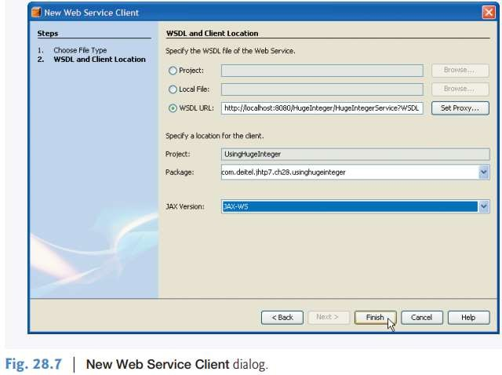

Slide 84
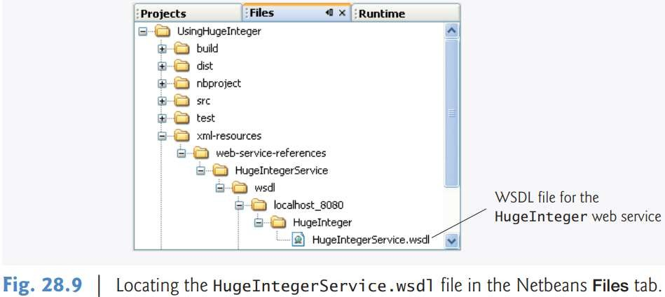

Slide 85
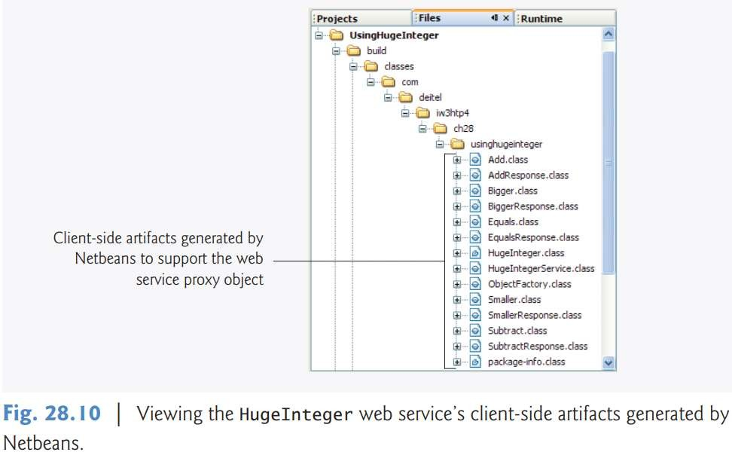

Slide 86
Consuming the HugeInteger Web Service
For this example, we use a GUI application to interact with the web service HugeInteger web service.
To build the client application’s GUI, you must first add a subclass of JFrame to the project.
To do so, perform the following steps:
Right click the project name in the Netbeans Project tab.
Select New > JFrame Form… to display the New JFrame Form
dialog.
Specify UsingHugeIntegerJFrame in the Class Name field.
Specify com.deitel.iw3htp4.ch28.hugeintegerclient in the Package field.
Click Finish to close the New JFrame Form dialog.

Slide 87
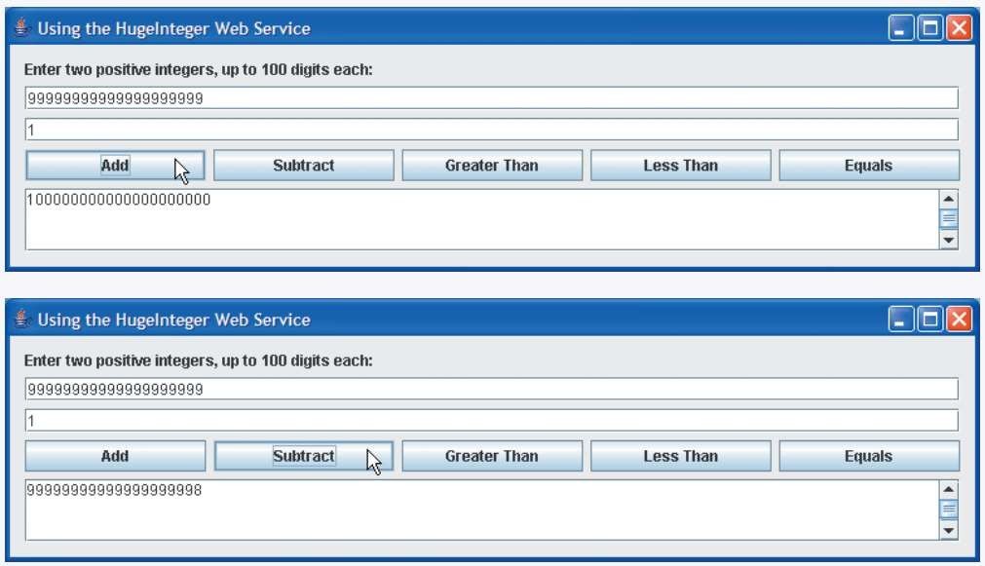

Slide 88
DATABASE DRIVEN WEB SERVICE FROM AN APPLICATION
The user registration/account registration form will be presented to the user. Once user fills in the form and clicks on the "OK" button, the server side JSP will call the webservice to register the user.
This webservices will expose the insert user operation which will be used by the JSP client to register the user. We will use the NetBeans 6.1 IDE to develop and test the application.
The MySQL database is used to save the user registration data. You can modify the code to use any database of your choice. The existing webservices can also be modified to use the Hibernate or any other ORM technologies. You can also use the Entity beans to persist the data into database.

Slide 89
DATABASE DRIVEN WEB SERVICE FROM AN APPLICATION
Example
Software required to develop and run this example:
JDK 1.6
NetBeans 6.1
MySQL Database 5 or above

Slide 90
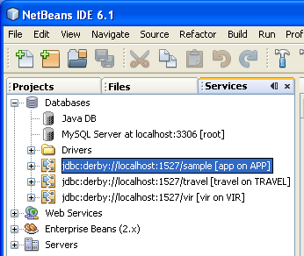
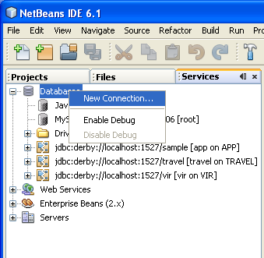
MySql Database Configuration In NetBeans
Let's configure MySQL database in teh NetBeans IDE and then create the required table into database.
Step 2
Right Click on the Databases
Select New Connection as shown below in Fig 2.
Step 1
Click on the service tab in NetBeans as
shown below in Fig 1

Slide 91
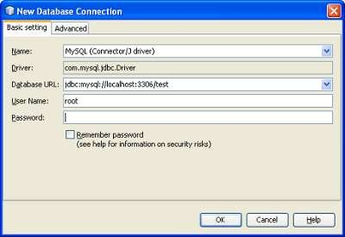
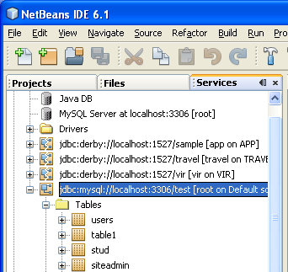
Step 3:
It opens a dialog box for the mysql configuration.
Type the driver name, url , user name and password as
shown below in Fig. 3.
Click on the Ok button .
Step 4:
Now expand the Newly created database connection.
It shows the all the tables of the database test as
shown below in Fig 4.

Slide 92
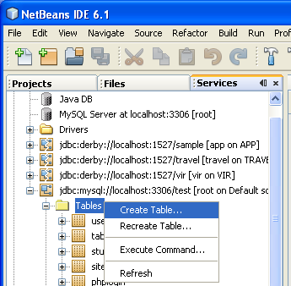
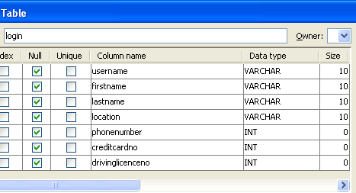
Step 6:
It opens a dialog box for giving the fields name of
the table
Now give the field name and data type as shown
below in Fig 6.
Step 5:
Create a table named login.
Right Click on the Tables and select Create
table as shown below in Fig 5
Step 7:
Click on the Ok
It creates the table login in the test database.

Slide 93
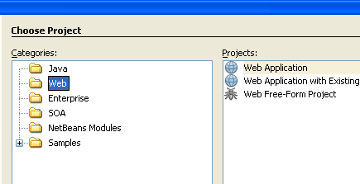
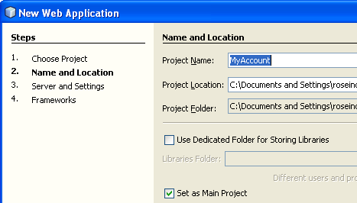
Creating the WebService program for Account creation
Step 8:
Open the netbeans 6.1
Creat a new web project as shown below in Fig 7.
Step 9:
Type the project Name as MyAccount
Click on the next button as shown below in Fig
8.

Slide 94
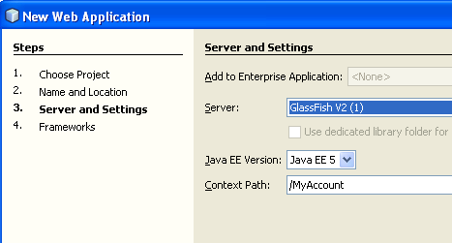
Step 10:
Select the server as Glassfish
Click on the Next and then finish button as shown below in Fig 9.
Step 11:
It creates a Web Project named MyAccount.

Slide 95
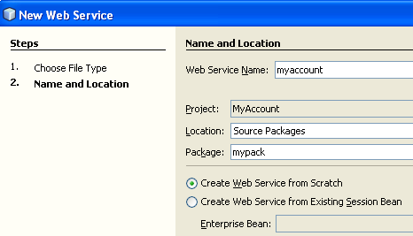
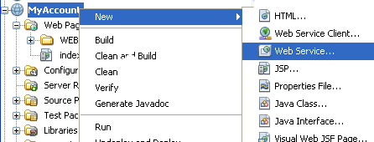
Creating the WebService
Step 12:
Right Click on the project MyAccount
Select New-->WebService as shown below in
Fig 10.
Step 13:
Type the name of the WebService as myaccount
with the package as mypack.
Click on the Finish button as shown below in Fig
11.
`

Slide 96
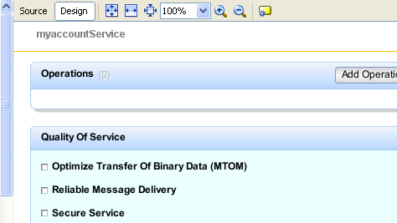
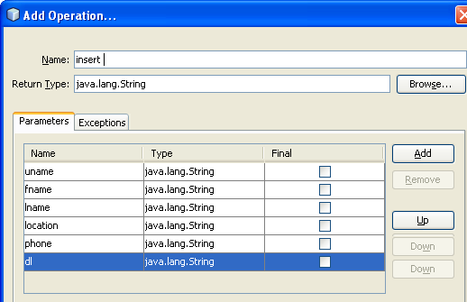
Step 14:
It creates a WebService application in design view
Click on the Add operation as shown below in Fig 12.
Step 15:
In the dialog box type all parameter names.
Also select the appropriate data type.
Click on Ok as shown below in Fig 13.

Slide 97
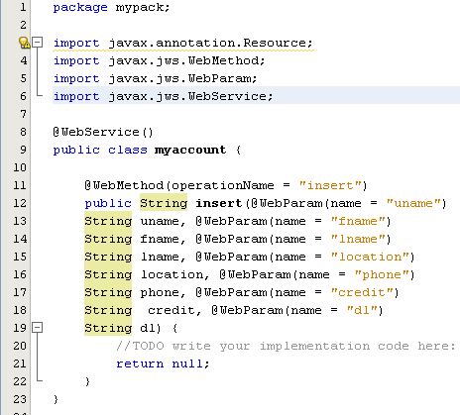
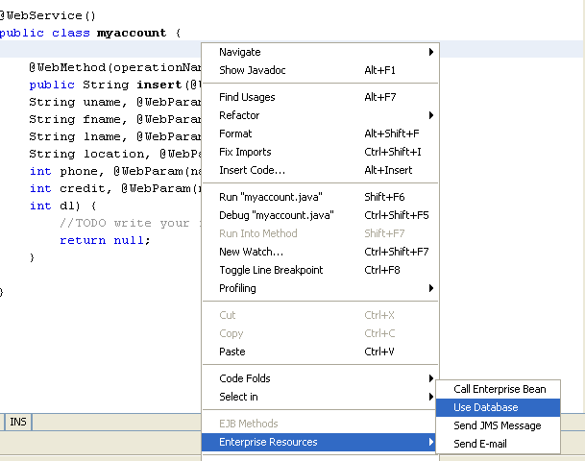
Step 17:
Now create the database source
Right Click in the source code of myaccount.java Select the Enterprise Resources-->Use Database as shown below in Fig 15.
Step 16:
It creates a WebService application
Click on the source tab as shown below in the Fig 14.

Slide 98
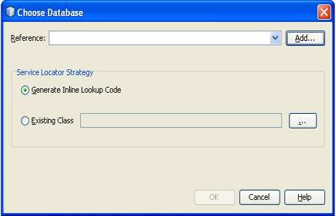
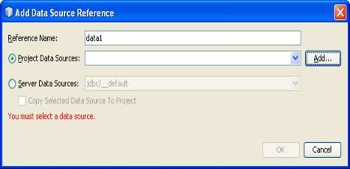
Step 19:
It opens a Add Data Source Reference.
Type the Reference Name as data1
For Project Data Sources Click on the Add button as shown below in Fig 17.
Step 18:
In the choose database select the Add button as shown
below in Fig 16.

Slide 99
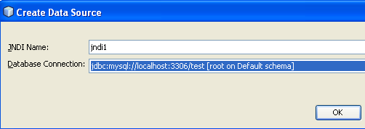
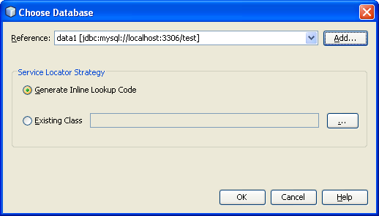
Step 20:
In the Crea Data Source type thye jndi name as jndi1
In the database connection select the newly created database connection for the mysql.
as shown below in Fig 18.
Step 21:
Click on the Ok button
It creates the database connection gives the dialog
box as shown below.
Click on the Ok button as shown below in Fig 19.

Slide 100
Types of web services
There are two types of web services:
RESTful Web Servies
SOAP Web Services

Slide 101
SOAP (Simple Object Access Protocol)
SOAP is an acronym for Simple Object Access Protocol.
It is an XML-based messaging protocol for exchanging information among computers.
SOAP is an application of the XML specification.
SOAP is a communication protocol designed to communicate via Internet.
SOAP can extend HTTP for XML messaging.
SOAP provides data transport for Web services.
SOAP can exchange complete documents or call a remote procedure.
SOAP can be used for broadcasting a message.
SOAP is platform- and language-independent.
SOAP is the XML way of defining what information is sent and how.
SOAP enables client applications to easily connect to remote services and invoke remote methods.

Slide 102
Although SOAP can be used in a variety of messaging systems and can be delivered via a variety of transport protocols, the initial focus of SOAP is remote procedure calls transported via HTTP.
Other frameworks including CORBA, DCOM, and Java RMI provide similar functionality to SOAP, but SOAP messages are written entirely in XML and are therefore uniquely platform- and language-independent.

Slide 103
SOAP Message Structure
A SOAP message is an ordinary XML document containing the following elements −
Envelope − Defines the start and the end of the message. It is a mandatory element.
Header − Contains any optional attributes of the message used in processing the message, either at an intermediary point or at the ultimate end-point. It is an optional element.
Body − Contains the XML data comprising the message being sent.
It is a mandatory element.
Fault − An optional Fault element that provides information about errors that occur while processing the message.
All these elements are declared in the default namespace for the SOAP envelope −
http://www.w3.org/2001/12/soap-envelope and the default
data types is −
namespace for SOAP encoding and
http://www.w3.org/2001/12/soap-encoding.

Slide 104
<?xml version = "1.0"?>
<SOAP-ENV:Envelope xmlns:SOAP-ENV = "http://www.w3.org/2001/12/soap-envelope"
SOAP-ENV:encodingStyle = "http://www.w3.org/2001/12/soap-encoding">
<SOAP-ENV:Header>
...
...
</SOAP-ENV:Header>
<SOAP-ENV:Body>
...
...
<SOAP-ENV:Fault>
...
...
</SOAP-ENV:Fault>
...
</SOAP-ENV:Body>
</SOAP_ENV:Envelope>

Slide 105
SOAP with HTTP POST
The following example illustrates the use of a SOAP message within an HTTP POST operation, which sends the message to the server.
It shows the namespaces for the envelope schema definition and for the schema definition of the encoding rules.
The OrderEntry reference in the HTTP header is the name of the program to be invoked at the tutorialspoint.com website.

Slide 106
POST /OrderEntry HTTP/1.1
Host: www.tutorialspoint.com
Content-Type: application/soap; charset="utf-8"
Content-Length: nnnn
<?xml version = "1.0"?>
<SOAP-ENV:Envelope
xmlns:SOAP-ENV = "http://www.w3.org/2001/12/soap-envelope"
SOAP-ENV:encodingStyle = " http://www.w3.org/2001/12/soap-encoding">
...
Message information goes here
...
</SOAP-ENV:Envelope>

Slide 107
SOAP request
POST /Quotation HTTP/1.0
Host: www.xyz.org
Content-Type: text/xml; charset = utf-8 Content-Length: nnn
<?xml version = "1.0"?>
<SOAP-ENV:Envelope
xmlns:SOAP-ENV = "http://www.w3.org/2001/12/soap-envelope"
SOAP-ENV:encodingStyle = "http://www.w3.org/2001/12/soap-encoding">
<SOAP-ENV:Body xmlns:m = "http://www.xyz.org/quotations">
<m:GetQuotation>
<m:QuotationsName>MiscroSoft</m:QuotationsName>
</m:GetQuotation>
</SOAP-ENV:Body>
</SOAP-ENV:Envelope>

Slide 108
SOAP response
HTTP/1.0 200 OK
Content-Type: text/xml; charset = utf-8
Content-Length: nnn
<?xml version = "1.0"?>
<SOAP-ENV:Envelope
xmlns:SOAP-ENV = "http://www.w3.org/2001/12/soap-envelope"
SOAP-ENV:encodingStyle = "http://www.w3.org/2001/12/soap-encoding">
<SOAP-ENV:Body xmlns:m = "http://www.xyz.org/quotation">
<m:GetQuotationResponse>
<m:Quotation>Here is the quotation</m:Quotation>
</m:GetQuotationResponse>
</SOAP-ENV:Body>
</SOAP-ENV:Envelope>

Slide 109
END

