Slide 1
Android - UI Layouts
A layout defines the visual structure for a user to interface with your app, such as in an activity.
Android provides a range of libraries, canonical starting points, and techniques to display and position content.

Slide 2
What is Android View?
A View is a simple building block of a user interface.
.A view is a small rectangular box that responds to user inputs.
Eg: EditText, Button, CheckBox, etc. It is a small rectangular box that can be TextView, EditText, or even a button.
It occupies the area on the screen in a rectangular area and is responsible for drawing and event handling.
View is a superclass of all the graphical user interface components.

Slide 3
Why and How to use the View in Android?
The use of a view is to draw content on the screen of the user’s Android device.
A view can be easily implemented in an Application using the java code.
View is a basic building block of UI (User Interface) in android.
ViewGroup is an invisible container of other views (child views) and other ViewGroup.
Eg: LinearLayout is a ViewGroup that can contain other views in it.

Slide 4
Types of Android Views

Slide 5
What is Android View Group?
A View Group is a subclass of the ViewClass and can be considered as a superclass of Layouts.
It provides an invisible container to hold the views or layouts.
ViewGroup instances and views work together as a container for Layouts.

Slide 6
What is Android Layout?
Layout basically refers to the arrangement of elements on a page these elements are likely to be images, texts or styles.
They define the structure of android user interface in the app, like in an activity.
All elements in the layout are built with the help of Views and ViewGroups.
These layouts can have various widgets like buttons, labels, textboxes, and many others.

Slide 8
Attributes of Layout in Android
The following are the attributes for customizing a Layout while defining it:
android:id: It uniquely identifies the Android Layout.
android:hint: It shows the hint of what to fill inside the EditText.
android:layout_height: It sets the height of the layout.
android:layout_width: It sets the width of the layout.
android:layout_gravity: It sets the position of the child view.
android:layout_marginTop: It sets the margin of the from the top of the layout.
android:layout_marginBottom: It sets the margin of the from the bottom of the layout.
android:layout_marginLeft: It sets the margin of the from the left of the layout.
android:layout_marginRight: It sets the margin of the from the right of the layout.
android:layout_x: It specifies the x coordinates of the layout.
android:layout_y: It specifies the y coordinates of the layout.

Slide 9
Types of Layouts in Android
Following are certain commonly used subclasses for ViewGroup:
Linear Layout
Relative Layout
Constraint Layout
Table Layout
Frame Layout
List View
Grid View
Absolute Layout
WebView
ScrollView
PICTORIAL REPRESENTATIONS OF DIFFERENT LAYOUTS

Slide 10
1. Linear Layout
LinearLayout organizes Views in a linear order, horizontally or vertically. A Linear manner means one element per line.
In this, arrangement of the elements is in a top to bottom manner.
It is straightforward and efficient for arranging elements in a single row or column.
This layout is particularly useful for creating forms, toolbars, or any interface where a sequential arrangement of elements is needed.
This can have two orientations: a. Vertical Orientation – It is shown above where the widgets such as TextViews, and all in a vertical manner. b. Horizontal Orientation – It is shown above where the widgets such as TextViews, and all in a horizontal manner.

Slide 12
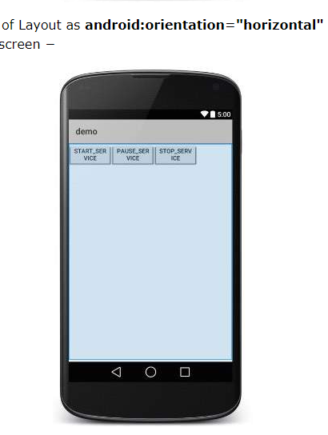

Slide 13
2. Relative Layout
This layout is for specifying the position of the elements in relation to the other elements that are present there.
In the relative layout, alignment of the position of the elements to the parent container is possible.
To define it in such a way, we write the following:
android:layout_alignParentTop= “true”
android:layout_alignParentLeft= “true”
If we write the above code, the element will get aligned on the top left of the parent container.
If we want to align it with some other element in the same container, it can be defined is as follows:
android:layout_alignLeft= “@+id/element_name”
android:layout_below= “@+id/element_name”
This will align the element below the other element to its left.

Slide 14
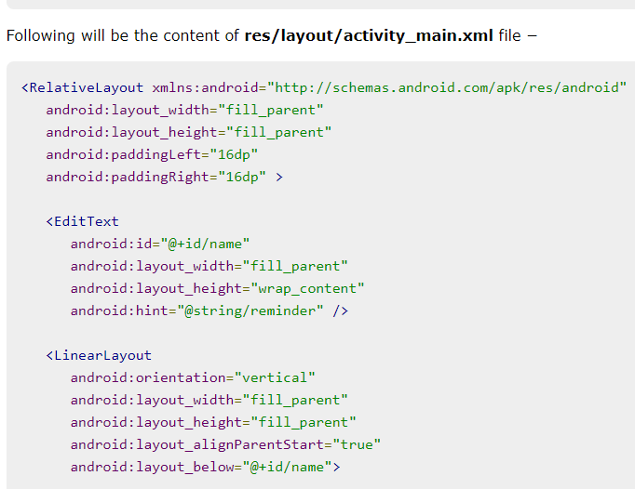

Slide 15
Android Table Layout
Android TableLayout going to be arranged groups of views into rows and columns.
You will use the <TableRow> element to build a row in the table.
Each row has zero or more cells; each cell can hold one View object.
TableLayout containers do not display border lines for their rows, columns, or cells.

Slide 16
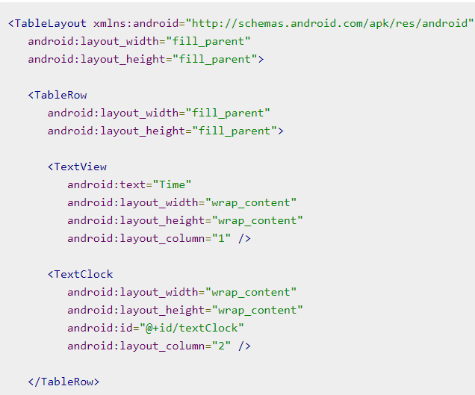

Slide 18
Android List View
Android ListView is a view which groups several items and display them in vertical scrollable list.
The list items are automatically inserted to the list using an Adapter that pulls content from a source such as an array or database.

