Slide 1
ANDROID VIEWS (AND WIDGETS)
A View is also known as Widget in Android.
Any visual(that we can see on screen) and interactive(with which user can interact with) is called a Widget.

Slide 2
Introduction to Android Views and ViewGroups
All the interaction of a user with the Android application is through the user interface(UI), hence it is very important to understand the basics about the User Interface of an android application.
Views
View is the basic building block of UI(User Interface) in android.

Slide 4
UI Elements
View refers to the android.view.View class, which is the super class for all the GUI components like TextView, ImageView, Button etc.
A View is an object that draws something on the screen that the user can interact with and
A ViewGroup is an object that holds other View (and ViewGroup) objects in order to define the layout of the user interface.
You define your layout in an XML file which offers a human-readable structure for the layout, similar to HTML.

Slide 5
View can be considered as a rectangle on the screen that shows some type of content.
It can be an image, a piece of text, a button or anything that an android application can display.
The rectangle here is actually invisible, but every view occupies a rectangle shape.

Slide 6
What can be the size of this rectangle?
The answer is either we can set it manually, by specifying the exact size(with proper units) or by using some predefined values.
These predefined values are match_parent and wrap_content.
match_parent means it will occupy the complete space available on the display of the device.
Whereas, wrap_content means it will occupy only that much space as required for its content to display.

Slide 7
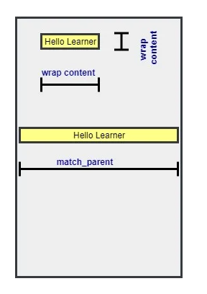
XML syntax for creating a View

Slide 8
It always start with an angle bracket, followed by the View name.
Then we write attributes that will define how that view will look on the screen of the application along with a value for the attribute.
Each view has its own attributes which we will discuss in the next few tutorials which will cover various types of views.
In the end, it is closed by />

Slide 9
There are two attributes that are necessary for every View.
These are:
android:layout_height and
android:layout_width.
These attributes define the size of the invisible rectangle that a view makes.
Using these attributes we can easily control the size for every view in our android application.
Apart from the above mentioned attributes, attributes like gravity, layout_gravity, padding and margin are some other commonly used attributes.

Slide 10
Most commonly used Android View classes
Here we have some of the most commonly used android View classes:
TextView
EditText
Button
ImageView
ImageButton
CheckBox
RadioButton
ListView
GridView
DatePicker
Spinner, etc.

Slide 14
Programmatic and Declarative Approach
To create/define a View or a ViewGroup in your android application, there are two possible ways:
The Programmatic Approach: In this we define/create our Views in the Java source file.
We will learn about this approach in details later, as of now here is a sample code to add a Button to our view.
Button myButton = new Button(this);
myButton.setLayoutParams(new LinearLayout.LayoutParams( LinearLayout.LayoutParams.MATCH_PARENT, LinearLayout.LayoutParams.MATCH_PARENT)); myLayout.addView(myButton);
So addView() is the function used to add any View to the UI and setLayoutParams() function is used to set the various attributes.
The Declarative Approach: In this we define the View and ViewGroups directly in the design XML files.

Slide 15
Create UI Controls
a view object may have a unique ID assigned to it which will identify the View uniquely within the tree.
The syntax for an ID, inside an XML tag is −
android:id="@+id/text_id“
To create a UI Control/View/Widget you will have to define a view/widget in the layout file and assign it a unique ID as follows:

Slide 17
TextView in Android
TextView is the most widely used view used to show pre-defined text on display screen.
This is a view which is not only used alone, but is also used along with other Views as well, like when you are creating a form, where you have EditText view, CheckBox view etc, then to mention the labels and other information, we will have to use the TextView alongside.

Slide 20
First we open the tag with < and type TextView, indicating we are creating a TextView that will get displayed in the app.
android:layout_width="wrap_content" and
android:layout_height="wrap_content" are compulsory to write for every view,
because we must define the width and height for every view that we create.

Slide 21
A view object may have a unique ID assigned to it which will identify the View uniquely within the tree. The syntax for an ID, inside an XML tag is −
android:id="@+id/my_button"
This gives an id(identification) to this textview which can be used in Java files to access this textview and to make any changes to it dynamically.
For example, suppose we set some initial text as "study".
But we want the text to be as "studytonight" after we touch the screen.
So, we use this id in our Java class and use some predefined function to change the text of the TextView during runtime, when the user taps on it.
Button myButton = (Button) findViewById(R.id.my_button);

Slide 22
android:text="StudyTonight“
The TextView will show the given value in the attribute as the text.
android:textSize="45sp“
This is used to determine the size of the text displayed in the TextView.
android:padding="20dp“
This provides a padding of 20dp around the text.
android:textColor="#DD2C00“
This sets the color of the text. #DD2C00 is the hexa code for color some dark red shade.

Slide 23
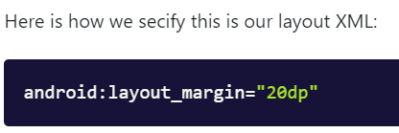
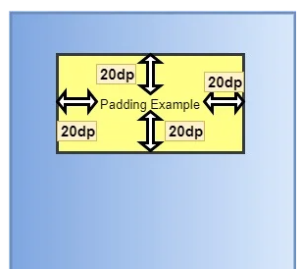
Margin and Padding with a View Margin → android:layout_margin Padding → android:padding

Slide 24
EditText View in Android
EditText is a TextView which is editable. It has almost similar properties as a TextView.
EditText is used when you want to have a text field in your application where user can enter any text.
It can be either single line or multi-line.
Touching a text field places makes the field active, places a cursor and automatically displays the keyboard.
Following are some of the attributes that are most commonly used:

Slide 25
Attribute -android:inputType
Used to specify what the text entered should be like and for what purpose it will be used.
If this is set to none, then the text cannot be edited.
Some commonly used constant values for this attribute are:

Slide 28
android:hint="Write your email address here“ This attribute gives a hint to the user about what should be entered in the box. This is a temporary message that goes off as soon as the user starts to write anything in the field.

Slide 29
ImageView and ImageButton in Android
ImageView and ImageButton are used in Android application to place an image in the view.
ImageButton is used to use an image as a button in your android application.
Therefore, any image that we want to display in the app should be placed under the drawable folder. This folder can be found under app → res → drawable.
To insert an image, simply copy the image and then right click on drawable → Paste.

Slide 30
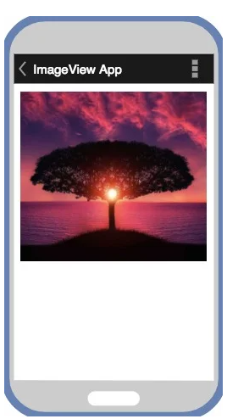
Following are some of the commonly used attributes with ImageView : android:background: This property gives a background color to your ImageView. When your image is not able to entirely fill the ImageView, then background color is used to fill the area not covered by the image. android:padding: To provide padding or extra space inside the ImageView for the image.

Slide 31
Using an Image as Button ImageButton has the same property as ImageView. Images set through ImageButton are clickable, and actions can be attached with them upon clicking.

Slide 33
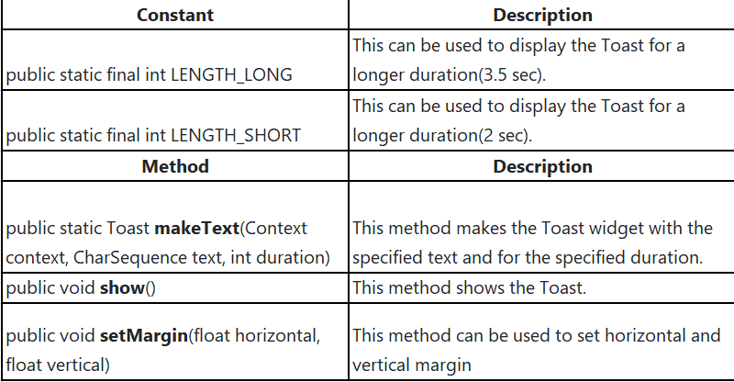
Toast in Android This is called a Toast in Android. It is used to display short and temporary messages in android apps.
Features of Toast
It is an Android widget that is used to show a message for a short duration of time.
It disappears after a short time.
It doesn't block the Activity or Fragment when it runs.
It can be used to give feedback to the user regarding any operations, like form submission etc.
How to Create a Toast?
A Toast can be created using the android.widget.Toast class, which extends the java.lang.Object class.

Slide 34
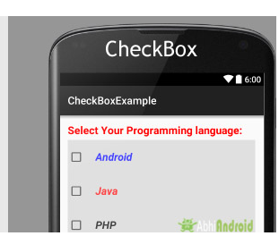
CheckBox View in Android
When you are creating a form to accept user inputs in your android application, and you have to list down a few options for the user to choose from, check boxes and radio boxes comes in handy.
CheckBox View in Android- Checkbox is used when you have to show multiple options to the user and the user is allowed to choose as many options as they want, by tapping on them.

Slide 35
Android UI How to - Change CheckBox text on select event

Slide 37
RadioButton View in Android RadioButton is used when you have to allow selection of only one option among the list of multiple options. It is used under its parent view – RadioGroup so that we can get one selected value out of all the listed radio buttons.

Slide 38
Android - RadioGroup Control A RadioGroup class is used for set of radio buttons.
Need to select male or female radio button then click on new button.
If you do above steps without fail, you would get a toast message after clicked by new button

Slide 39
Android Progress Bar using ProgressDialog
Progress bars are used to show progress of a task.
For example, when you are uploading or downloading something from the internet, it is better to show the progress of download/upload to the user.

Slide 40
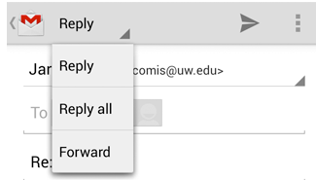
Spinner in Android-A Spinner allows you to select an item from a drop down menu. It creates a menu with multiple options where a user can select any one option.

Slide 41
Android - Time Picker
Android Time Picker allows you to select the time of day in either 24 hour or AM/PM mode.
The time consists of hours, minutes and clock format.
Android provides this functionality through TimePicker class.
In order to use TimePicker class, you have to first define the TimePicker component in your activity.xml.
It is define as below −
<TimePicker android:id="@+id/timePicker1" android:layout_width="wrap_content" android:layout_height="wrap_content" />

Slide 42
After that you have to create an object of TimePicker class and get a reference of the above defined xml component.
Its syntax is given below.
import android.widget.TimePicker;
private TimePicker timePicker1;
timePicker1 = (TimePicker) findViewById(R.id.timePicker1);
getCurrentHour() and getCurrentMinute() method of the TimePicker Class.
Their syntax is given below.
int hour = timePicker1.getCurrentHour();
int min = timePicker1.getCurrentMinute();

Slide 43
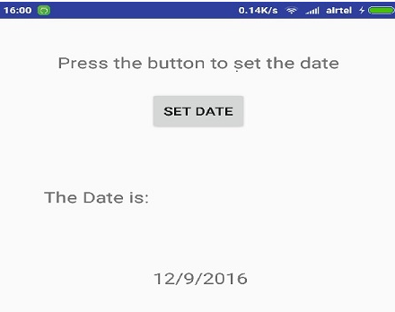
Android - Date Picker
Android Date Picker allows you to select the date consisting of day, month and year in your custom user interface.
For this functionality android provides DatePicker and DatePickerDialog components.

Slide 44
Adapters in Android- In Android, Adapter is a bridge between UI component and data source that helps us to fill data in UI component. It holds the data and send the data to an Adapter view then view can takes the data from the adapter view and shows the data on different views like as ListView, GridView, Spinner etc.
How does a Spinner works?
Define the data source.
There should be a data source that will be used to display the data in the spinner.
String days[] = {"Monday", "Tuesday", "Wednesday", "Thursday", "Friday", "Saturday", "Sunday"};
A data source can be a list, an array, a JSON data or data coming from a database.
If you want to select only one value from a set of options then you should use a Spinner.
If you want to display a list of data then use a list view.

Slide 45
Types of Adapters In Android:
There are the some commonly used Adapter in Android used to fill the data in the UI components.
BaseAdapter – It is parent adapter for all other adapters
ArrayAdapter – It is used whenever we have a list of single items which is backed by an array
Custom ArrayAdapter – It is used whenever we need to display a custom list
SimpleAdapter – It is an easy adapter to map static data to views defined in your XML file
Custom SimpleAdapter – It is used whenever we need to display a customized list and needed to access the child items of the list or grid

Slide 46
Adapter Example In Android Studio:
Below is the Android Studio example which show the use of the Adapter in Android.
In this example we display a list of fruits names with images by using SimpleAdapter and whenever user click on a list item the fruit’s name displayed in a Toast.

Slide 47
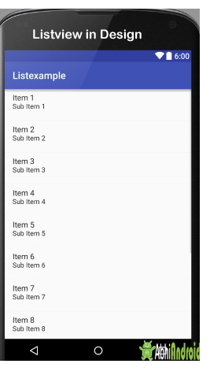
Android List View ListView, is a view group that displays a list of scrollable items. The list items are automatically inserted to the list using an Adapter that pulls content from a data source such as an array or database table and converts each dataitem into a view that is placed in the list.
Android ListView is a view which groups several items and display them in vertical scrollable list.
The list items are automatically inserted to the list using an Adapter that pulls content from a source such as an array or database.

Slide 48
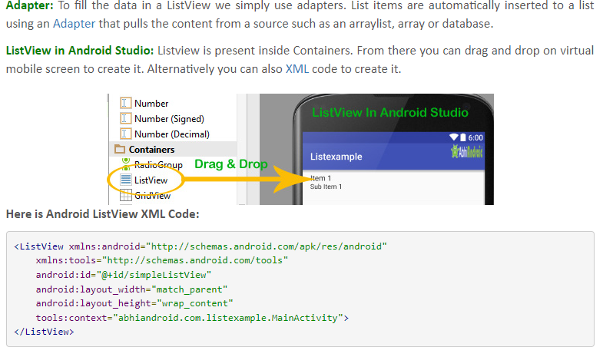

Slide 49
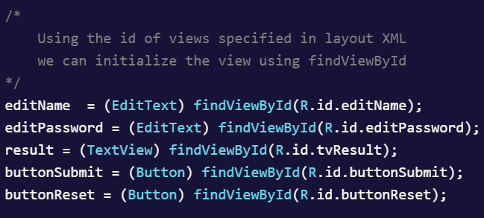
Get Value from the EditText and Set value to the TextView
As the name of the method suggests,
findViewById() returns an instance for the view defined in layout XML.
findViewById() method returns only View,
but it does not tell which view is returned
i.e. whether the view is Button, TextView, EditText, etc.
Therefore, you need to typecast the view returned by this method.

Slide 50
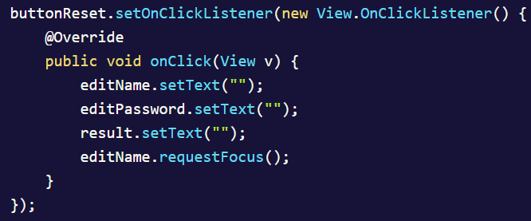

Slide 51
Android - ToggleButton Control
In Android, a ToggleButton is a UI element that allows the user to toggle between two states, typically representing an on/off or true/false condition.
If you have clicked first on Button, you would get a message on Toast as You have clicked first ON Button-:) or else if you clicked on second on button, you would get a message on Toast as You have clicked Second ON Button -:)

Slide 53
Android Event Listeners
What are Listeners?
Android Listeners are used to capture events. When, for instance, the user interacts with the Android system by clicking on a button, the Listeners would prompt the underlying activity to do the task associated with the button click.
Therefore, whenever you want the Android system to perform a task (when an event occurs), Listeners are at work.
In the Android system, there are more than 20 Listeners but a few are more frequently.

Slide 54
What are the most commonly used Listeners?
In Android development, listeners are interfaces or classes that are used to detect and respond to specific events or user interactions within an Android application.
Listeners are crucial for handling various events like button clicks, touch gestures, item selections, etc.
The following basic Listeners are the most commonly used:
OnClickListener
OnTouchListener
OnDateSetListener

Slide 55
OnClickListener OnClickListener is used when one wants to execute a task in the event of a click.
OnClickListener: Used to handle the click events on UI elements like buttons.
It requires the implementation of the onClick method.
Example: On the click of the button, a toast will display the number of clicks.

Slide 56
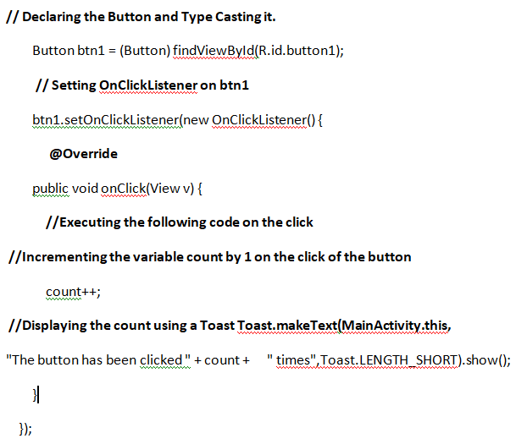
Example: On the click of the button, a toast will display the number of clicks.
a) Declare a variable Globally outside the onCreate method:
//Declaring the variable to count the number of clicks
int count = 0;
b) In the onCreate method implement the following.
Here, we are setting an OnClickListener on a Button:

Slide 57
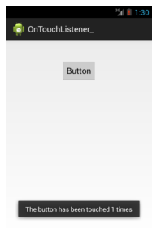
2. Android OnTouchListener
OnTouchListener is used to capture a touch event and execute the task associated with it.
Example : On button touch, a toast will be displayed with the count (the number of times the touch event occurs).

Slide 59
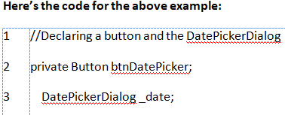
3. OnDateSetListener
It is used to fetch the selected date from a DatePicker widget.
Example : On button click a DatePickerDialog appears from which you can select a date.
After making the selection, and clicking the Done button, a toast will appear with the selected date.

Slide 60
Implement the following in the onCreate method. Here we are setting an OnClickListener on a Button

Slide 61
OnCheckedChangeListener: Used for handling changes in the state of checkboxes or radio buttons

Slide 62
OnItemSelectedListener: Used for handling item selections in Spinner (dropdown) widgets.

Slide 63
onMenuItemClick() method: In Android, when you're working with options menus or context menus, you can use the onMenuItemClick() method to handle the selection of a menu item. This method is part of the MenuItem.OnMenuItemClickListener interface.
In summary, onOptionsItemSelected() is commonly used to handle menu item clicks within the activity, and
OnMenuItemClickListener() is used when you want to set a specific listener for a menu item.

Slide 64
OnMenuItemClickListener() interface:
The OnMenuItemClickListener interface is used when you want to set a listener for a specific menu item. This interface defines the onMenuItemClick(MenuItem item) method, and you can use it to handle the click event for that specific menu item.
Here's an example:
MenuItem menuItem = menu.findItem(R.id.menu_item_id);
menuItem.setOnMenuItemClickListener(new MenuItem.OnMenuItemClickListener() {
@Override
public boolean onMenuItemClick(MenuItem item) {
// Handle the click event for the specific menu item
return true;
}
});

